Slide 1
Integrated Model of Continued Professional Development (CPD)
&
Maintenance of License (MoL)
Presented by:
Prof Shajila Singh
&
Dr Therese Fish

Slide 2
Structure of the presentation
Introduction - Registration vs Licence
Purpose of Maintenance of Licence (MoL)
Challenges with current CPD & HPCSA response
Rationale for MoL
Integrated model for CPD and MoL
Where are we in the process?
Questions

Slide 3
Introduction registration vs license
REGISTRATION
2007 CPD compulsory: professions registered with the HPCSA
LICENSE
HPCSA 2013: practitioners required to have a license to practice profession
Goal: Encourage update of knowledge and skills for ethical & competent practice
Currently: registration on an annual basis to practice profession
HPCSA conducts random checks on adherence
With licensure: demonstrate compliance with Board’s requirements
5-year licensure credentialing cycle

Slide 4
Primary purpose for MoL
Ensure that all Practitioners maintain and improve their Professional Knowledge, Skills and Performance for improved patient/client and health systems outcomes

Slide 5
So why not cpd?
Current focus of CPD: Primarily Continuing Education (CE) to update knowledge;
Research: Acquired knowledge meaningful only when it offers an opportunity for a change in practice;
Translation of knowledge into practice - not optimal with a lag between acquiring knowledge and applying it in practice (Mickan, 2014, Wallace and May, 2016) ;
Lag impact profound (Wallace and May, 2016)
30% to 40% of patients don’t receive care informed by best evidence;
20% to 50% receive inappropriate care.

Slide 6
the HPCSA response
HPCSA critically reflected on current CPD program considering research & international trends;
CPD should be: patient / client centered, more comprehensive, include a wide range of learning activities (not only CE), focus on improved practice and outcomes and be linked to MoL;
Goal: guide genuine learning & enable improvement of professional competence and performance.

Slide 7
Shift in thinking [cpd]
Currently CPD requires practitioners to record the number of credits
Equating number of continuing education units (CEUs) with competence is erroneous (Ahmed, et al, 2013) & doesn’t indicate genuine learning or change performance quality
2013 HPCSA survey - 67.5% of practitioners, across Boards, engaged with CPD because it was a mandatory expectation of the HPCSA

Slide 8
Shift in thinking [cpd]
There is a need to move from engaging with CPD because it is Mandatory → using CPD for improving practice
Currently, many practitioners meet mandatory CPD CEUs opportunistically, erratically or casually (Ahmed, et al., 2013)
CPD impact limited when undertaken in an ad hoc manner, and contributes little to improved clinician performance or patient/client health outcomes (Wallace & May, 2016).

Slide 9
Evidence for comprehensive CPD for MoL
Learning activities that –
enhance participant activity,
use multiple exposures to content,
encourage reflection on current practices,
provide opportunities to practice skills and
help clinicians identify gaps between current performance and an identified standard
Often result in highly significant changes in practice and patient outcomes (Wallace & May 2016).

Slide 10
Rationale for Mol
Comprehensive CPD Models - practitioners set out their CPD requirements and demonstrate how their CPD activities improve their professional performance and patient/client health
Such models recognize that different professionals will have different development needs and require practitioners to take greater ownership of their professional development
The new HPCSA Model will shift control of learning to individual health practitioners, enabling them to reflect on their learning needs and to design their own learning programmes (Institute of Medicine, 2009)

Slide 11
Rationale for Mol cont.
Input-based systems (Wallace & May 2016) like CPD in South Africa - delivered primarily through lectures, conferences & workshops (HPCSA CPD Survey 2013)
Such systems are simple, cost effective and provide an easily quantifiable method of measuring individual CPD activity (Wallace & May, 2016)
A CPD programme should effectively address the gap between optimal evidence-based practice and actual clinical practice (Légaré F et al, 2015).

Slide 12
Rationale for Mol cont.
Didactic Learning Activities
little effect on improving competence and performance
no significant effect on patient health outcomes and health systems (Shibu 2015; Wallace & May 2016)
Internationally, Professional Bodies have moved towards outcomes based CPD (Wallace & May, 2016)

Slide 13
Rationale for mol cont.
Empower practitioners to reflect on their learning and development needs
Pursue an individualized learning program to improve:
knowledge
performance
patient outcomes
health systems strengthening
Given the evidence: HPCSA proposes a more comprehensive model of CPD

Slide 14
Rationale for mol cont.
Engagement with this model of
CPD requires Practitioners to
demonstrate knowledge and
performance in order to maintain a
license to practice.

Slide 15
Evidence for mol
Knowledge
A lower rate of mortality and morbidity in patients was reported for surgeons and cardiologists who underwent certification (MOL) compared to those who lacked certification (Ahmed, et al., 2013).
Clinical Skills
Pediatricians using multiple skills acquisition methods showed significant improvement in skills (Ahmed, et al., 2013).

Slide 16
EVIDENCE for mol cont.
Clinician Performance
Interactive CPD sessions involving skills training effects change in professional practice and healthcare outcomes (Ahmed, et al., 2013)
CPD significantly reduced the age-related decline in the diagnostic performance of general practitioners (Butterworth and Reppert, cited in Ahmed, et. al., 2013)

Slide 17
HPCSA strategy
MOL model based on outcomes of consultative workshops held with Professional Boards during 2014 - 2015, and further developed by CPD & Professional Board teams 2017-2019.
Principles:
Process is developmental and supports professional development
MOL will be a quality improvement process i.e. improving the quality of health care
Engender public confidence in health care practitioners’ knowledge and performance.

Slide 18
HPCSA MODEL FOR MOL
What does practitioner need to do?
Reflect on own practice

Slide 19
HPCSA MODEL FOR MOL
Reflect on own practice across domains
DOMAINS OF PRACTICE
Professionalism
Safety & Quality
Communication
Knowledge, Skills & Performance

Slide 20
Domains of practice
Practice requires competencies that extend beyond professional knowledge and skills and includes:
Communication
Professionalism
Interpersonal Collaboration

Slide 21
Domains of practice

Slide 22
SA Domains & Sub-domains
PROFESSIONALISM
Good practice
SAFETY AND QUALITY
Integrity
Intercultural competence
Systems to protect patients/clients/ health practitioners
Respond to risks to safety
Protect patients/ clients/ health practitioners from risks posed by colleagues
COMMUNICATION
Communicate effectively
KNOWLEDGE, SKILLS AND PERFORMANCE
Develop and maintain professional performance
Apply knowledge and experience to practice
Maintain clear, accurate and legible records
Work constructively with colleagues

Slide 23
HPCSA MODEL FOR MOL
Reflect on own practice
HOW - Tools
ESSENTIAL KNOWLEDGE
Accredited self assessment programs
ON WHAT
PERFORMANCE
Chart audit and feedback
360/ Multisource Feedback
Direct observation
Peer engagement and feedback
Practice assessment
Accredited simulation activities
Annual performance review
Critical incident
Adverse events
DOMAINS
1. Professionalism
2. Safety & quality
3. Communication
4. Knowledge, skills &
performance

Slide 24
HPCSA MODEL FOR MOL
Reflect on own practice
Accredited self assessment programs (essential knowledge quiz)
Chart audit and feedback
360/ Multisource Feedback
Direct observation
Peer engagement and feedback
Practice assessment
Accredited simulation activities
Annual performance review
Critical incident
Adverse events
ON WHAT
DOMAINS
1. Professionalism
2. Safety & quality
3. Communication
4. Knowledge, skills &
performance
Determine Learning Needs

Slide 25
HPCSA Model for mol
Determine Learning Needs
Develop Individualized Learning Plan

Slide 26
HPCSA Model for mol
Develop Individualized Learning Plan
Engage with CPD
(expanded range of options)

Slide 27
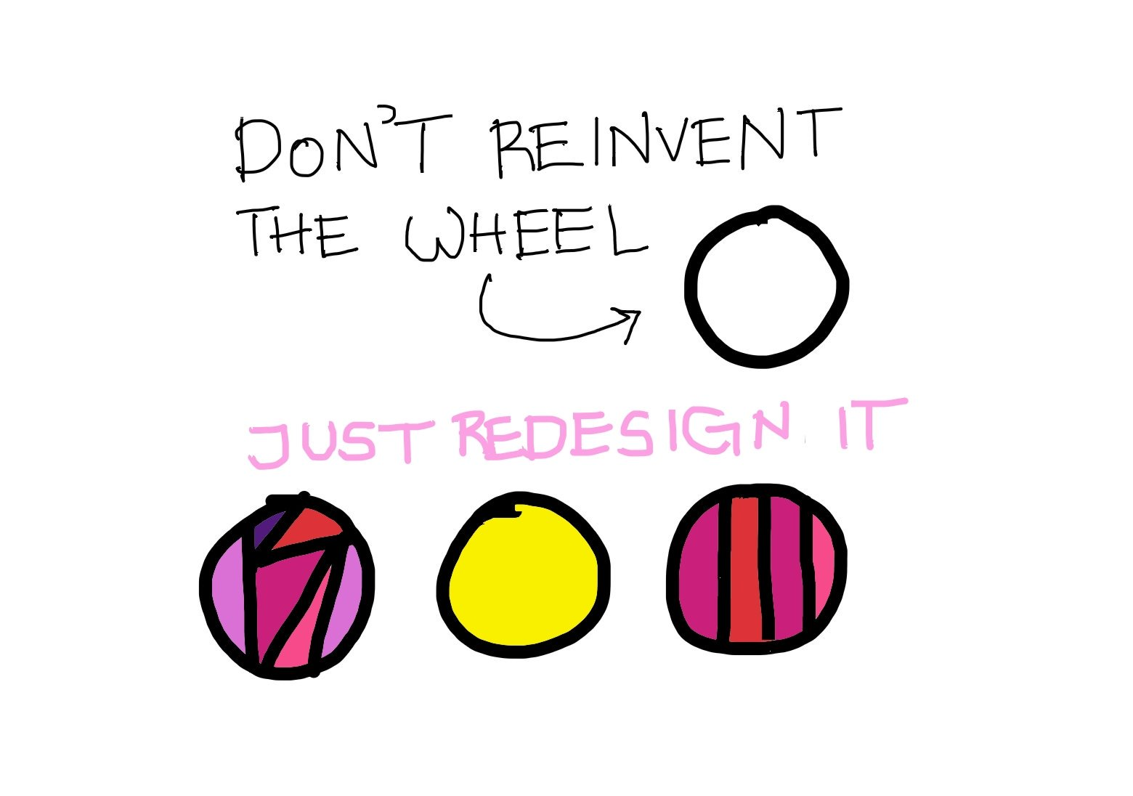
Are we reinventing the wheel?
How:
Use our existing practices for knowledge and skills acquisition
Leverage on what works best
e.g. laboratory professionals have
Quality Assurance processes
(SANAS) which can support MoL
Fit for the purpose of maintaining license to practice

Slide 28
Adaptation of royal college of physicians of canada
Includes what practitioners may already be doing; recognizes self study and unaccredited activities.
Broad categories
Group learning
Individual
Formal learning
Self learning
Systems? learning
Assessment

Slide 29
EXPANDED RANGE OF CPD options (Royal college of physicians Canada 2019)
Group Learning Credits (tbc)
Accredited Group Learning Activities (face to face; online) | Conferences, Rounds, Journal clubs, Small groups | 1 credit/hour
Unaccredited Group Learning activities (face to face; online) No industry sponsorship | Rounds, Journal clubs, Small groups | 0.5 credits/ hour

Slide 30
EXPANDED RANGE OF CPD options (Royal college of physicians Canada 2019)
Formal Learning Learning activities initiated by a practitioner (independently or in collaboration with peers or mentors) to address a need, problem, issue or goal relevant to their professional practice | Fellowships | Credits (tbc) 100 credits/year
 | Formal courses | 25 credits/course
 | Personal learning projects | 2 credits/hour
 | Traineeships | 2 credits/hour

Slide 31
EXPANDED RANGE OF CPD options (Royal college of physicians Canada 2019)
Self Learning Learning activities used by a practitioner to enhance their awareness of new evidence, perspectives or discoveries that are potentially relevant to their professional practice | Reading a book | 10 credits/book
 | Reading a book chapter | 2 credits/chapter
 | Reading a journal volume | 2 credits/volume
 | Reading a journal article | 1 credit/article
 | Bulk journal reading with transcript | 1 credit/article
 | Bulk online reading/scanning with transcript | 1 credit/hour
 | Podcasts, audio, video | 0.5 credits/activity
 | Internet searching (Medscape, UpToDate, DynaMed) | 0.5 credits/activity
 | POEMs Patient oriented evidence that matters | 0.25 credits/activity

Slide 32
EXPANDED RANGE OF CPD options (Royal college of physicians Canada 2019)
Systems Learning Learning stimulated by participation in activities such as setting practice standards, patient safety, continuous quality improvement; curriculum development; assessment tools and strategy development; examination board membership; or peer review. | Clinical practice guideline development | 20 credits/year
 | Quality care/patient safety committee | 15 credits/year
 | Curriculum development | 15 credits/year
 | Examination development | 15 credits/year
 | Peer review | 15 credits/year

Slide 33
Credit for Assessments - MOL
Assess Knowledge and Performance

Slide 34
MOL Component - Knowledge (Royal college of physicians Canada 2019)
KNOWLEDGE ASSESSMENT
Programs provide data with feedback to individual practitioners regarding their current knowledge base, enabling the identification of needs and development of future learning opportunities relevant to their practice
ESSENTIAL KNOWLEDGE
Accredited self assessment programs (credits for completion)

Slide 35
MOL Component - performance (Royal college of physicians Canada 2019)
PERFORMANCE ASSESSMENT
PERFORMANCE (credits)
Activities that provide data with feedback to individual practitioners, groups or interprofessional health teams related to their personal or collective performance across a broad range of professional practice domains. Performance assessment activities can occur in a simulated or actual practice environment.
Chart audit & feedback
360/ Multisource Feedback
Direct observation
Peer engagement & feedback
Practice assessment
Accredited simulation activities
Annual performance review
Critical incident
Adverse events

Slide 36
Assessments
Board specifies min requirements: which knowledge & performance assessments are applicable, how many credits, etc.
Dashboard
Based on probity of practitioners
Developmental
Feedback
Decentralized
Multiple opportunities

Slide 37
HPCSA MODEL FOR MAINTENANCE OF LICENCE TO PRACTICE
Assess knowledge & performance across domains
Engage with CPD
Apply learning to practice
Determine learning needs
Develop learning plan
Demonstrate learning i.e. knowledge and performance meets Board’s standards
Implement learning plan
Maintain learning log
i.e. Repository of CPD activities

Slide 38
Required activities FOR LICENSURE
Minimum requirements (determined by Professional Board) for each year in each category - with ethics as a transversal requirement
Group Learning
Self Learning
Assessment
Essential knowledge
Performance

Slide 39
Timeframes
ANNUAL
EVERY FIVE YEARS
Complete minimum number of credits per year in each category (CPD & Assessment i.e. MoL)
Meet all annual requirements AND
If meet min – then adherent
If not – then non-adherent – triggers notice to practitioner and board
Total number of credits (including minimum in each category)
If meet all requirements – licensed
If not – non-compliant – not licensed

Slide 40
Timeframes CONT.
Year 1 |  | Year 2 |  | Year 3 |  | Year 4 |  | Year 5
A |  | A |  | A |  | A |  | A
B |  | B |  | B |  | B |  | B
C |  | C |  | C |  | C |  | C
Year 1 to 5
Every year practitioners should be adherent to the minimum credits in the 3 groups (a % of the total for that year) and within 5 years achieve the total number of HPCSA determined credits across all three to be licenced
A = Individual CPD activities (expanded)
B = Group CPD activities (expanded)
C = Assessment
Weightings in each category to be determined by the professional boards

Slide 41
License to practice
Demonstrated requisite knowledge and skills – continue to practice for next 5 years
Enter next cycle of licensure credentialing

Slide 42
Failure to obtain license
Requisite knowledge, skills and performance not demonstrated by end of 5-year period – not safe
License to Practice not issued
Cannot practice profession

Slide 43
THE MoL DEVELOPMENT PHASE

Slide 44
What is the development phase?
Three volunteer Professional Boards, CPD Committee, HPCSA Secretariat
MDB, MTB, OCP – Max variation: Acute setting, Lab Science, Sustained engagement/rehab; Ability to scale up
Begin to engage with roles & responsibilities related to MoL
Develop MoL toolkit, plans for stakeholder engagement, HPCSA readiness, governance

Slide 45
QUESTIONS

Slide 46
References
Ahmed K, Wang TT, Ashrafian H, Layer GT, Darzi A, Athanasiou T. The effectiveness of continuing medical education for specialist recertification. Canadian Urological Association Journal. 2013 Jul;7(7-8):266. https://doi.org/10.5489/cuaj.378
Expanded range of CPD options, Royal college of physicians Canada 2019
IOM (Institute of Medicine). 2010. Redesigning Continuing Education in the Health Professions. Washington, DC: The National Academies Press
Légaré F, Freitas A, Thompson-Leduc P, Borduas F, Luconi F, Boucher A, Witteman HO, Jacques A. The majority of accredited continuing professional development activities do not target clinical behavior change. Academic Medicine. 2015 Feb 1;90(2):197-202.
Mickan, S. (2014). Using Knowledge to Action Practice Change. [online] Available at: http://www.cebm.net/wp-content/uploads/2014/07/Using-knowledge-to-action-practice-change.pdf
Shibu L, Rajab E, Eldabi T. The role of social media in continuing professional development of physical therapists: a review of the literature. Physiotherapy. 2015 May 1;101:e1384. https://doi.org/10.1016/j.physio.2015.03.1328
Wallace S, May SA. Assessing and enhancing quality through outcomes-based continuing professional development (CPD): a review of current practice. The Veterinary record. 2016 Nov 19;179(20):515. https://doi.org/10.1136/vr.103862

